Slide 1


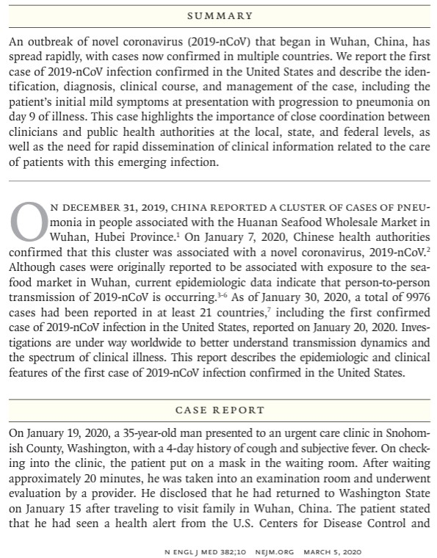
Case Reports: Example
First case of COVID-19 in USA
Scan the text and answer:
  How many cases are described in detail?
    Where do you see evidence to support this is a single case?
  Person
    What basic characteristics of the patient are provided?
  Place
    Where did this case occur?
    Where did the outbreak begin?
  Time
    When was this case identified relative to the outbreak timeline?
  What is being described vs. inferred?
    Which parts describe this patient?
    Which parts reference broader context?
7
Source: https://www.nejm.org/doi/full/10.1056/nejmoa2001191

